Slide 1

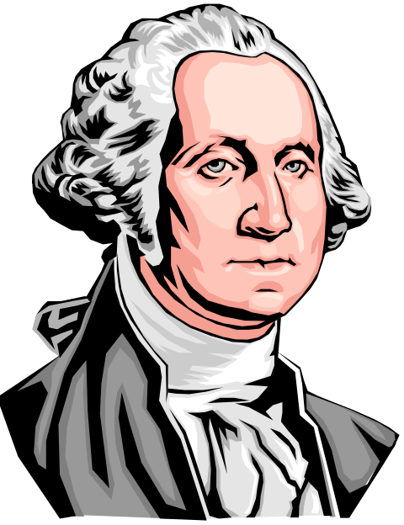
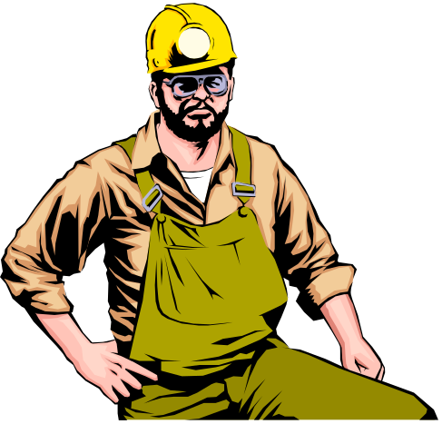
Leadership
What is a leader?
Who is a leader?
Can I be a leader?

Slide 2
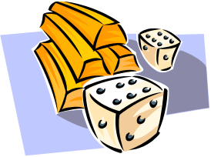
The student will be able to:
Discuss leadership orally, leaving no gaps or overlays
List traits of effective leaders orally, with near accuracy
Explain leadership style and contrast three styles with no errors
Name three misunderstandings about leadership with no errors
Contrast leadership with power and management according to the power point projection

Slide 3

Leadership is a relationship where influence is given to meet individual or group goals.

Slide 4

A leader is a person who helps an individual or a group of individuals in achieving their goals.
A leader does not always have to be the president, or the elected leader. It may be an active leader of the group, or someone who reaches out to help another person.
A follower is an individual who follows the ideas, goals, or tasks of a leader. Followers are developed by working together to identify goals and strategies for achieving the goals.

Slide 5

REMEMBER…
If there are no followers, there are no leaders. If roles are not understood, the group will not operate effectively!!

Slide 6
Traits of Effective Leaders
Know strengths and weaknesses
Hard working
Self confidant
Speak effectively in front of people
Follow directions
Think logically
Make decisions
Solve problems
Trustworthy
Listen effectively
Understand the needs of others
Respect people of other backgrounds

Slide 7
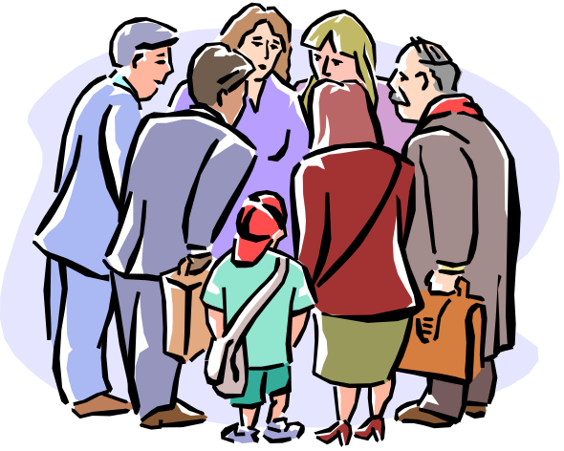
Leadership Styles
Autocratic Style
Laissez-faire Style
Democratic Style

Slide 8
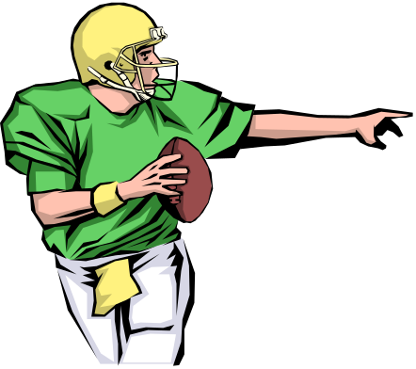
Autocratic Style
An autocratic leader is directive and makes decisions for an individual or group. Being autocratic does not mean the leader is coercive or a dictator. The leaders usually provide direction and make decisions.

Slide 9
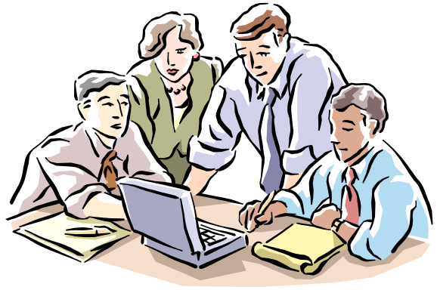
Laissez-faire Style
A Laissez-faire leader gives others a major role in making decisions. They recognize that involving group in the decision-making process is important. They often realize that group members are in a better position to make a decision.

Slide 10
Democratic Style
A democratic leader selects a style between autocratic and laissez-faire. Democratic leaders recognize the importance of participation by members, but retain part of the decision-making responsibility.

Slide 11
Six Misconceptions
Leaders are born, not made
Leadership comes from positions in the group
Leaders make all decisions for the group
All leaders are popular and charismatic
Leadership is power
Leadership is management

Slide 12
Summary
Tomorrow we will begin talking about ethics and how they are the building blocks that provide a solid foundation for our lives!
Have a Nice Day!

